Slide 1

Mendeley

Slide 2

BUSINESS PRESENTATION (LILI)
DESCRIPTION OF THE COMPANY
KEY FIGURES/VALUES
CATCHING THE EYE OF THE AUDIENCE !!! CAUSE GOD IMPRESSION

Slide 3

DATA SOURCE (RUPESH)
WHAT WERE THE FILES
WHAT DATA DID EACH ONE GIVE US
KEEP IT SIMPLE
EXPLAIN WHAT INFORMATION WE HAVE

Slide 4
Mendeley's Data Source

Slide 5
Mendeley's Dataset
Mendeley stores information about the customers, orders, shipping and other details in three CSV formatted files.
The dataset consists of many records and the data includes both numerical and categorical features.
The dataset includes transactional records that represent quantifiable facts which is used in dimensional modelling.

Slide 6
Mendeley's Dataset
Transactional data related to Shipping, profit per order, sales per customer, quantities per order, product discounts and product prices are highlighted.
The dataset consists of more than a year of transactional history.

Slide 7

DATA DISCOVERY (HENRIQUE)
MAIN INSIGHTS
MAIN GRAPHS AND IMAGES
GIVE AN OVERALL VIEW OF THE DATA
MAIN CATEGORIES
SALES PER REGION
LATE DELIVERY
PRODUCTS/ORDERS WE ARE LOSING MONEY

Slide 9




PERSPECTIVE OF ANALYSIS
SALES
What is the key products in term of Product sales?
KPIs on sales – Annually, quarterly, monthly
Is there any seasonality in the products purchasing patterns?
Where is the key market of the company?
SUPPLY CHAIN
Measure on-time delivery KPI
Average shipment time to each region in the world
What is the preferred shipment mode?

Slide 10
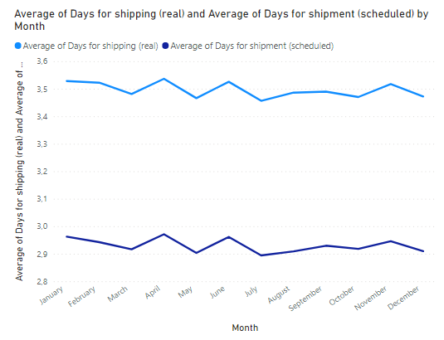
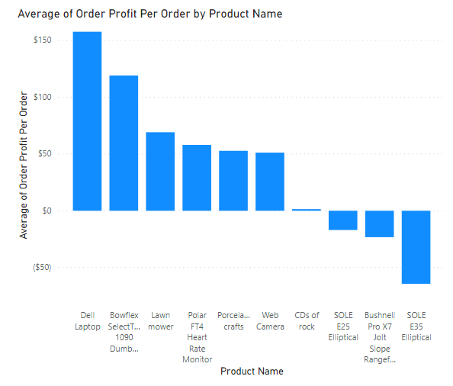
BUSINESS PROBLEM
SALES
SUPPLY CHAIN

Slide 11
MODEL (PHUC)

Slide 12
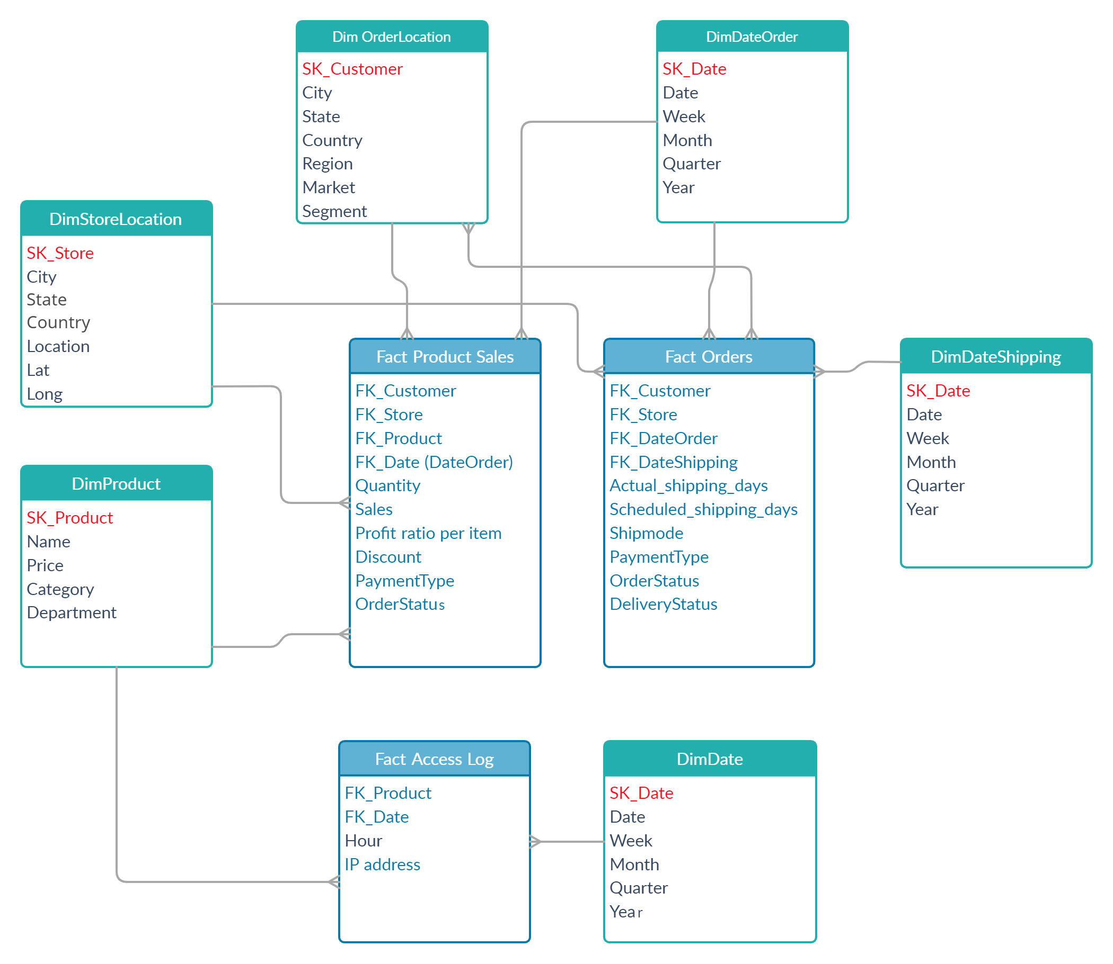







MODEL
3 Fact tables
Product Sales
Orders
Access Log
6 Dimension tables with 4 hierarchies
Product Dimension
Store Location Dimension
Order Location Dimension
Category
City
City
Department
State
State
Country
Country
Date Dimensions
Region
Market
Month
Quarter
Year

